Slide 1
Database Systems
AICT005-4-1-Database Systems (version1)
Week 2: File System

Slide 2
Topic & Structure of The Lesson
File System
Problems with file system
Data redundancy
Database environment components
DBMS functions

Slide 3
Learning Outcomes
At the end of this topic, You should be able to
Explain what is file system and its problems
Understand data redundancy
State the types of data anomaly
List the components in database environment
Describe DBMS functions

Slide 4
Key Terms You Must Be Able To Use
If you have mastered this topic, you should be able to use the following terms correctly in your assignments and exams:
File system
Data redundancy
Data anomaly

Slide 5
Why Database Design is Important
Defines the database’s expected use
Different approach needed for different types of databases
Avoid redundant data
Poorly designed database generates errors → leads to bad decisions → can lead to failure of organization

Slide 6
Historical Roots: Files and File Systems
Managing data with file systems is obsolete
Understanding file system characteristics makes database design easier to understand
Awareness of problems with file systems helps prevent similar problems in DBMS
Knowledge of file systems is helpful if you plan to convert an obsolete file system to a DBMS

Slide 7
Historical Roots: Files and File Systems (continued)
Manual File systems:
Collection of file folders kept in file cabinet
Organization within folders based on data’s expected use (ideally logically related)
System adequate for small amounts of data with few reporting requirements
Finding and using data in growing collections of file folders became time-consuming and cumbersome

Slide 8
Historical Roots: Files and File Systems (continued)
Conversion from manual to computer system:
Could be technically complex, requiring hiring of data processing (DP) specialists
Resulted in numerous “home-grown” systems being created
Initially, computer files were similar in design to manual files (see Figure 1.3)

Slide 9
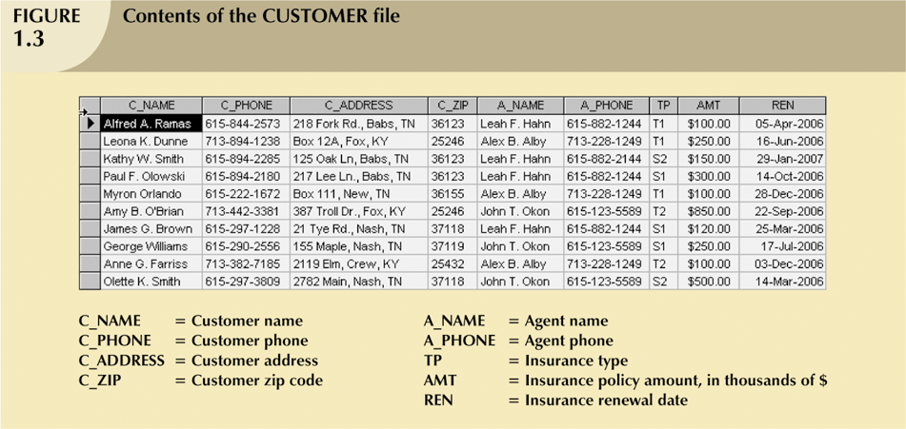
Historical Roots: Files and File Systems (continued)

Slide 10
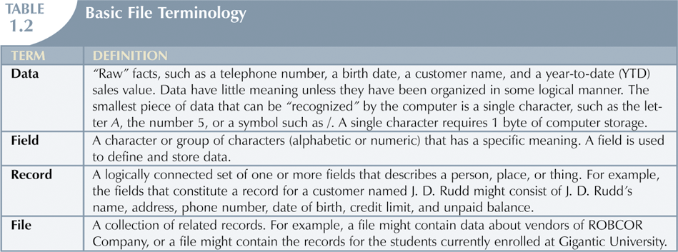
Historical Roots: Files and File Systems (continued)

Slide 11
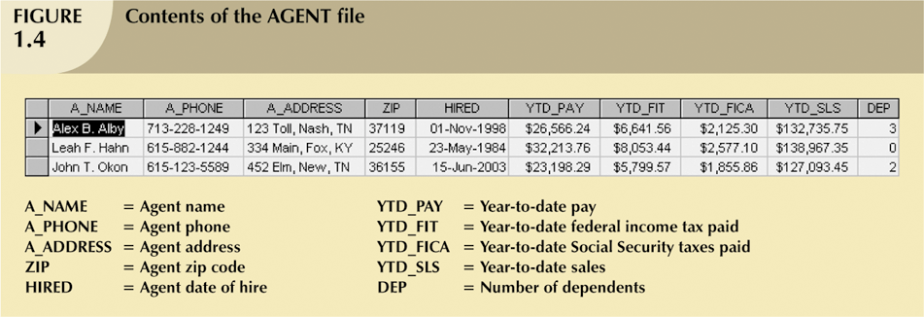
Historical Roots: Files and File Systems (continued)

Slide 12
Historical Roots: Files and File Systems (continued)
As number of databases increased, small file system evolved
Each file used its own application programs
Each file was owned by individual or department who commissioned its creation

Slide 13
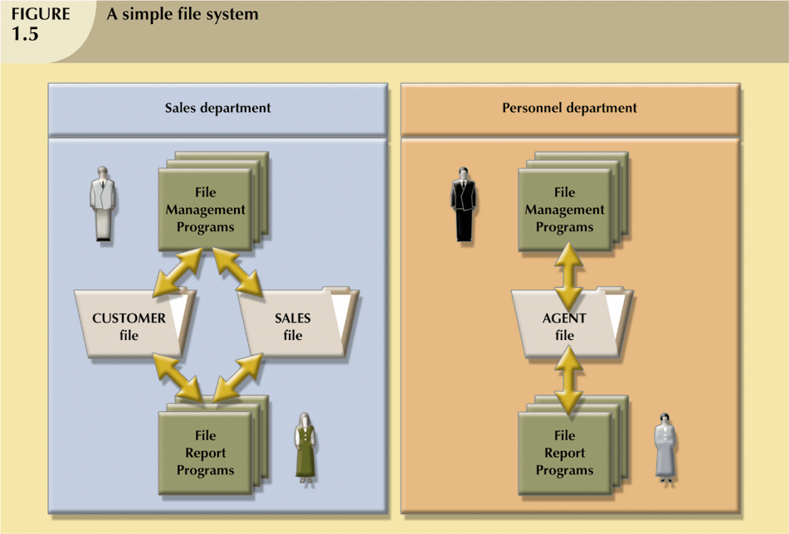
Historical Roots: Files and File Systems (continued)

Slide 14
Problems with File System Data Management
Time-consuming, high-level activity
As number of files expands, system administration becomes difficult
Making changes in existing file structure is difficult
File structure changes require modifications in all programs that use data in that file

Slide 15
Problems with File System Data Management
Modifications are likely to produce errors, requiring additional time to “debug” the program
Security features hard to program and therefore often omitted

Slide 16
Data Redundancy
Data redundancy results in data inconsistency
Different and conflicting versions of the same data appear in different places
Errors more likely to occur when complex entries are made in several different files and/or recur frequently in one or more files
Data anomalies develop when required changes in redundant data are not made successfully

Slide 17
Data Redundancy
Types of data anomalies:
Update anomalies
Occur when changes must be made to existing records
Insertion anomalies
Occur when entering new records
Deletion anomalies
Occur when deleting records

Slide 18
Database Systems
Problems inherent in file systems make using a database system desirable
File system
Many separate and unrelated files
Database
Logically related data stored in a single logical data repository

Slide 19
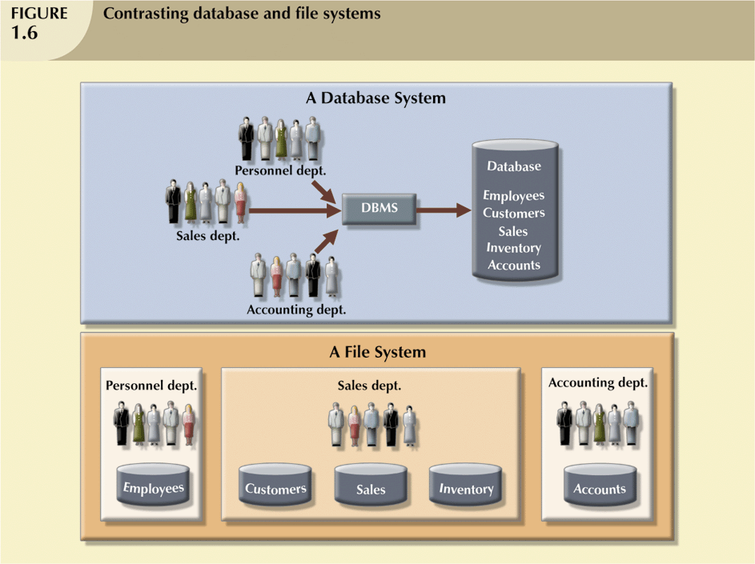
Database Systems

Slide 20
The Database System Environment
Database system is composed of five main parts:
Hardware
Software
Operating system software
DBMS software
Application programs and utility software
People
Procedures
Data

Slide 21
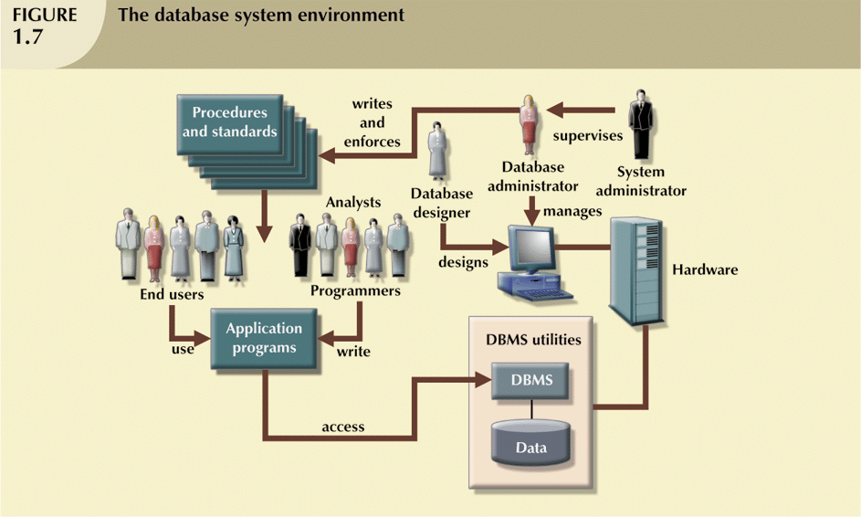
The Database System Environment (continued)

Slide 22
DBMS Functions
DBMS performs functions that guarantee integrity and consistency of data
Data dictionary management
defines data elements and their relationships
Data storage management
stores data and related data entry forms, report definitions, etc.

Slide 23
DBMS Functions (continued)
Data transformation and presentation
translates logical requests into commands to physically locate and retrieve the requested data
Security management
enforces user security and data privacy within database

Slide 24
DBMS Functions (continued)
Multiuser access control
uses sophisticated algorithms to ensure multiple users can access the database concurrently without compromising the integrity of the database
Backup and recovery management
provides backup and data recovery procedures
Data integrity management
promotes and enforces integrity rules

Slide 25
DBMS Functions (continued)
Database access languages and application programming interfaces
provide data access through a query language
Database communication interfaces
allow database to accept end-user requests via multiple, different network environments

Slide 26
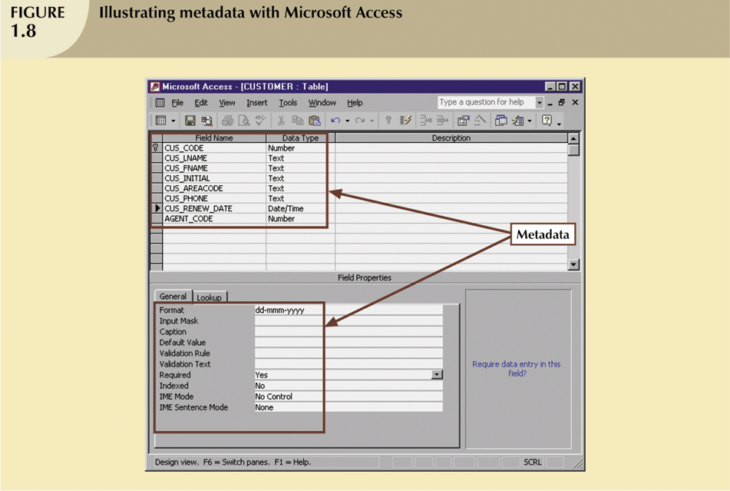
DBMS Functions (continued)

Slide 27
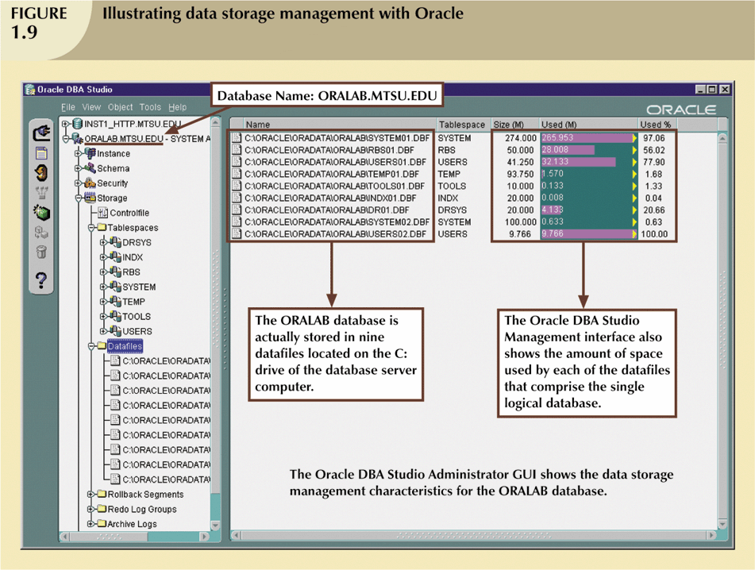
DBMS Functions (continued)

Slide 28
Quick Review Question
What are the disadvantages of file based system
What is data redundancy?
Explain different types of data anomaly
Describe 3 functions of DBMS

Slide 29
Summary of Main Teaching Points
Databases were preceded by file systems.
Limitations of file system data management:
requires extensive programming
system administration complex and difficult
making changes to existing structures is difficult
security features are likely to be inadequate
independent files tend to contain redundant data
DBMS’s were developed to address file systems’ inherent weaknesses

Slide 30
Question and Answer Session
Q & A

Slide 31
What we will cover next
Data model
Business rules
Entity relationship model

